Slide 1

前沿数据库系统发展趋势
VLDB 2024总结：云数据库与HTAP
张超
中国人民大学

Slide 2
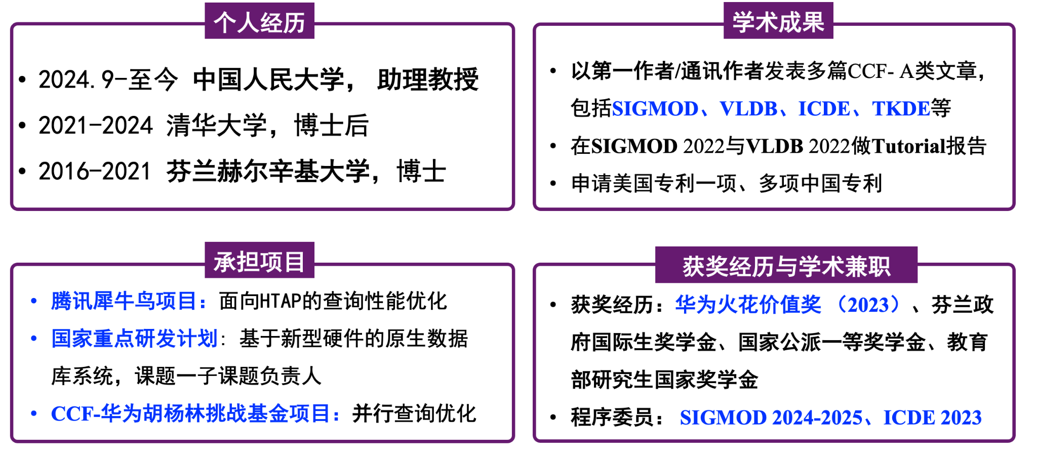
自我简介-张超（人大数据库-范举团队）

Slide 3
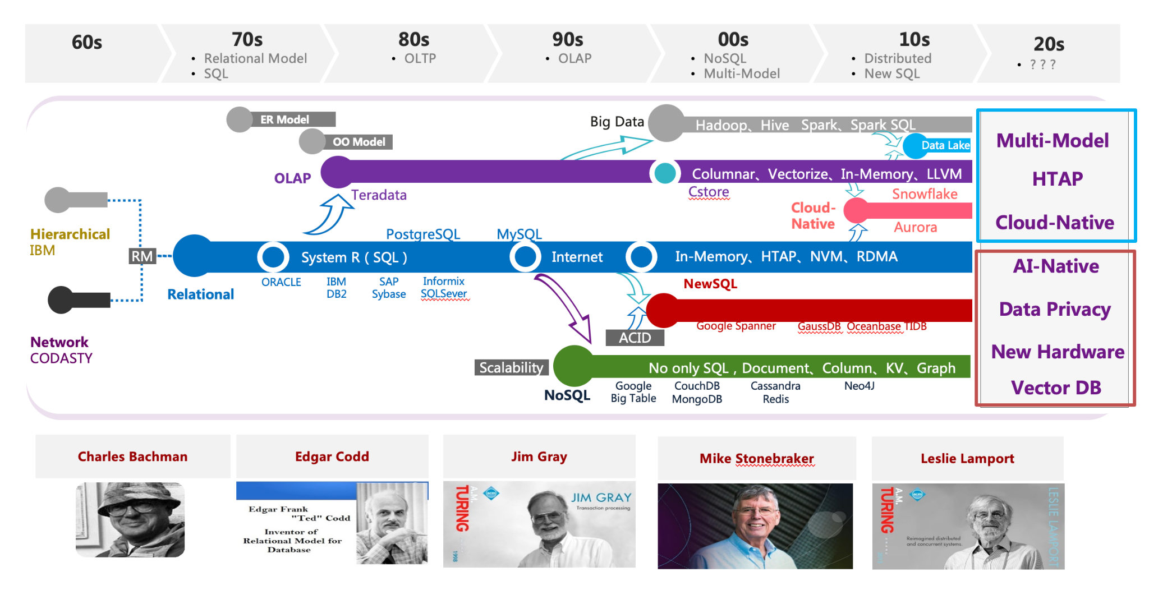
数据库领域发展总体方向

Slide 4
论文列表(云数据库+HTAP)
HTAP趋势：HTAP与云数据库、新硬件、多模不断融合, 技术重心从“计算”逐渐转到“存储”
HyBench: A New Benchmark for HTAP Databases. PVLDB, 2024.
Two Birds With One Stone: Designing a Hybrid Cloud Storage Engine for HTAP. PVLDB, 2024.
Deploying Computational Storage for HTAP DBMSs Takes More Than Just Computation Offloading. PVLDB, 2023.
Galaxybase: A High Performance Native Distributed Graph Database for HTAP. PVLDB, 2024.
===============================================================================================================
云数据库趋势：多写技术、Cost-Efficiency、智能化持续发展
GaussDB: A Cloud-Native Multi-Primary Database with Compute-Memory-Storage Disaggregation. PVLDB, 2024.
Resource Management in Aurora Serverless. PVLDB, 2024.
Srivastava, Tapan, and Raul Castro Fernandez. "Saving Money for Analytical Workloads in the Cloud." PVLDB, 2024.

Slide 5
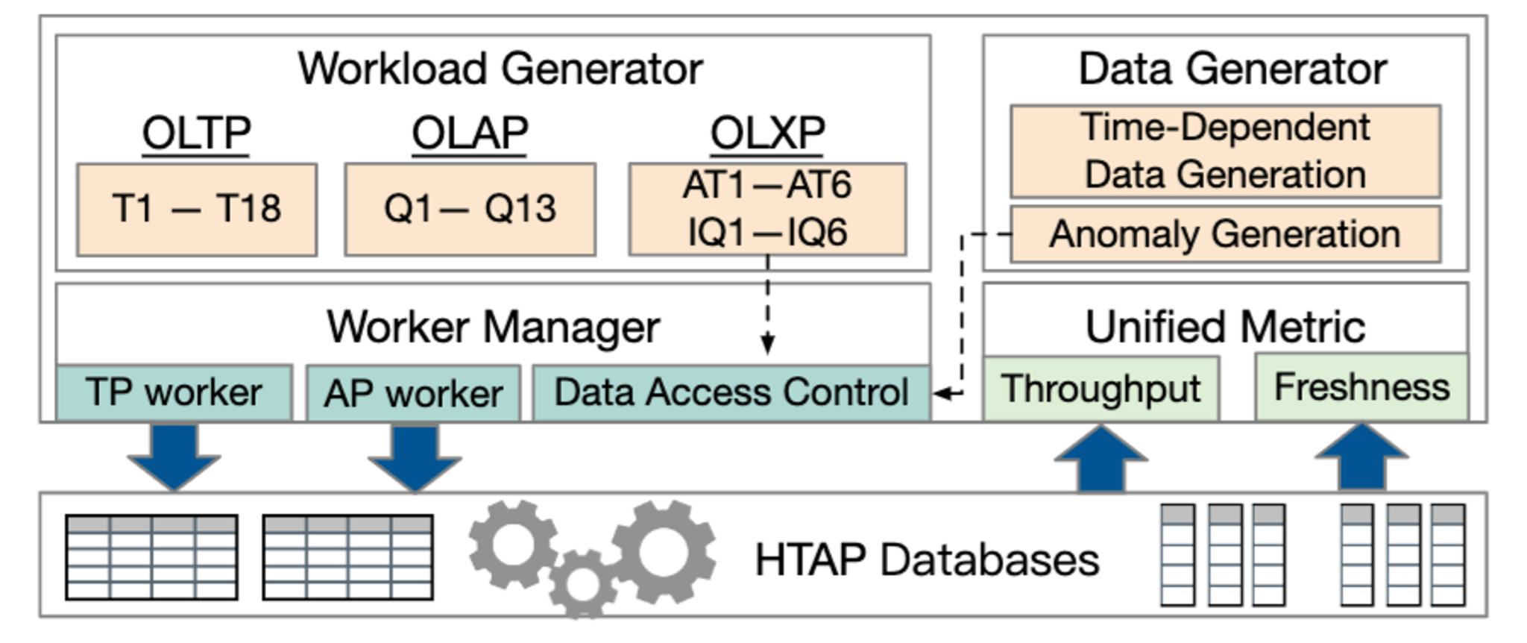
HyBench: A New Benchmark for HTAP Databases
Contribution 1: ﻿It proposes a new benchmark for HTAP databases based on an HTAP-native application.
Contribution 2: It proposes a hybrid workload of OLTP, OLAP, and OLXP, based on the choke-point design.
Contribution 3: It designs a unified metric to quantify the quality of HTAP databases, including freshness and throughput.

Slide 6
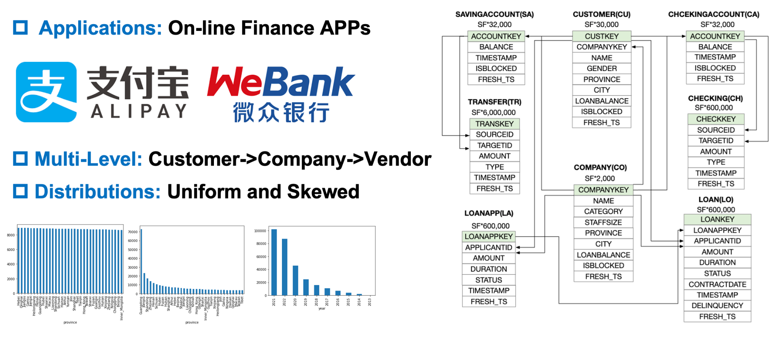
HyBench: A New Benchmark for HTAP Databases

Slide 7
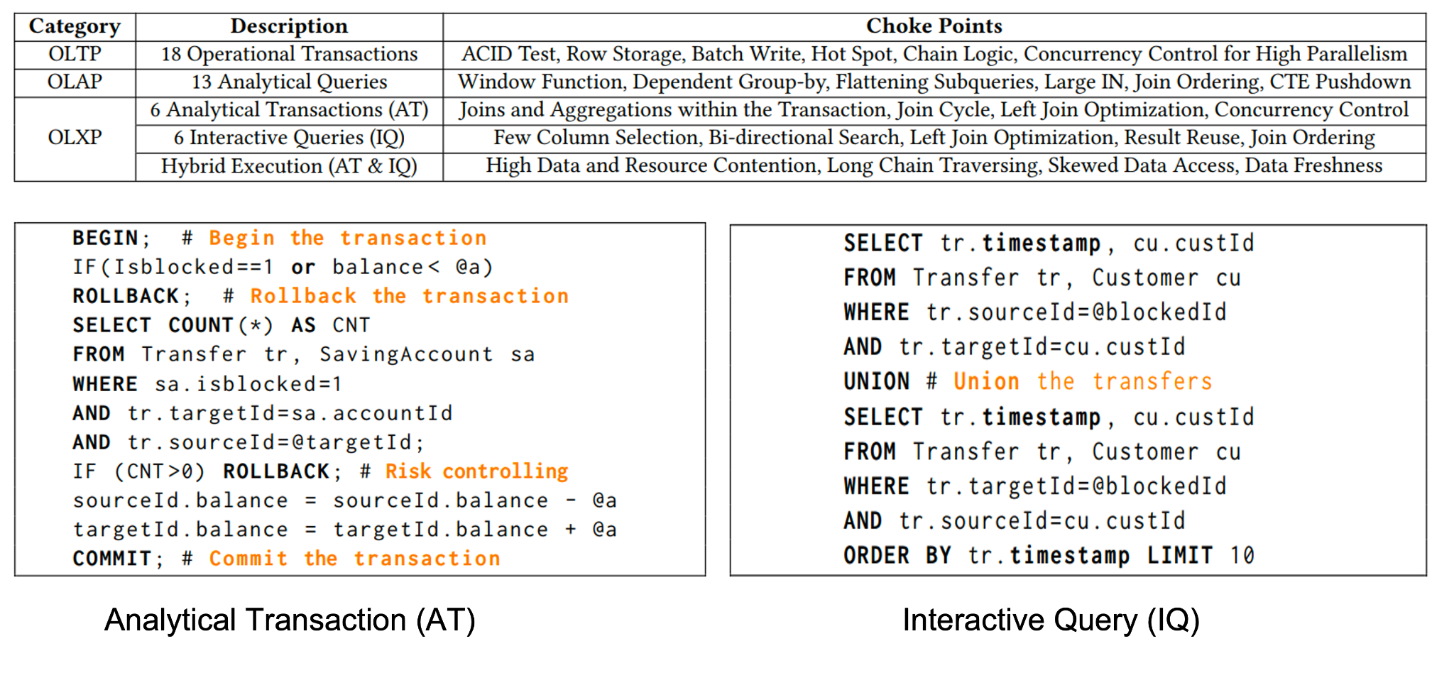
HyBench: A New Benchmark for HTAP Databases
Main Techniques

Slide 8
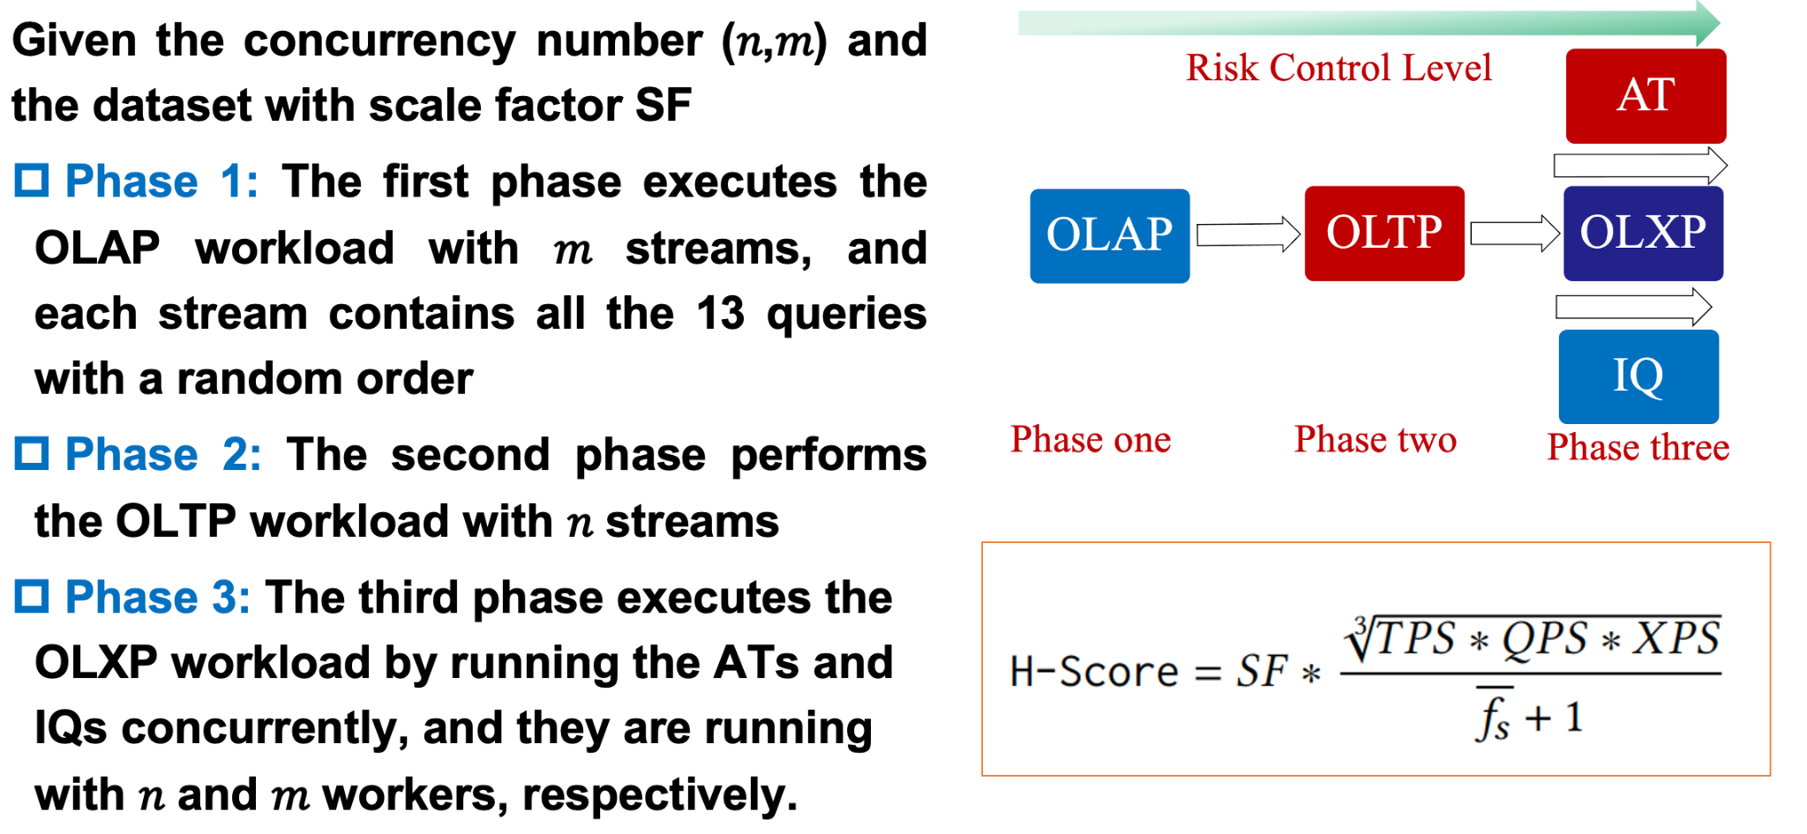
HyBench: A New Benchmark for HTAP Databases

Slide 9
HyBench: A New Benchmark for HTAP Databases
一些启发：
没有“银弹”技术，不同HTAP数据库技术适用于不同的业务场景
行列共存技术是HTAP的一个重要亮点，未来还有很大提升空间
一个“好”的数据库基准需要贴近真实场景，并且要不断在多样类型的数据库测评中打磨，与用户不断交互中迭代

Slide 10
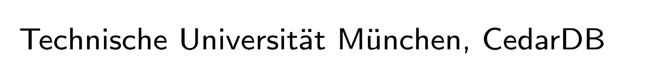
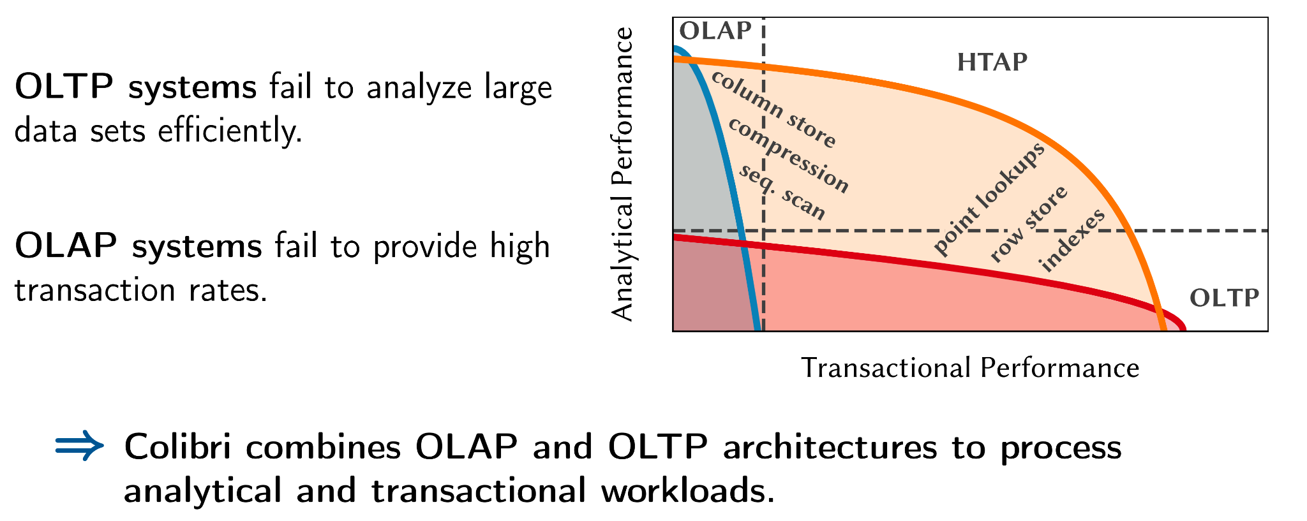
Colibri：Designing a Hybrid Cloud Storage Engine for HTAP

Slide 11
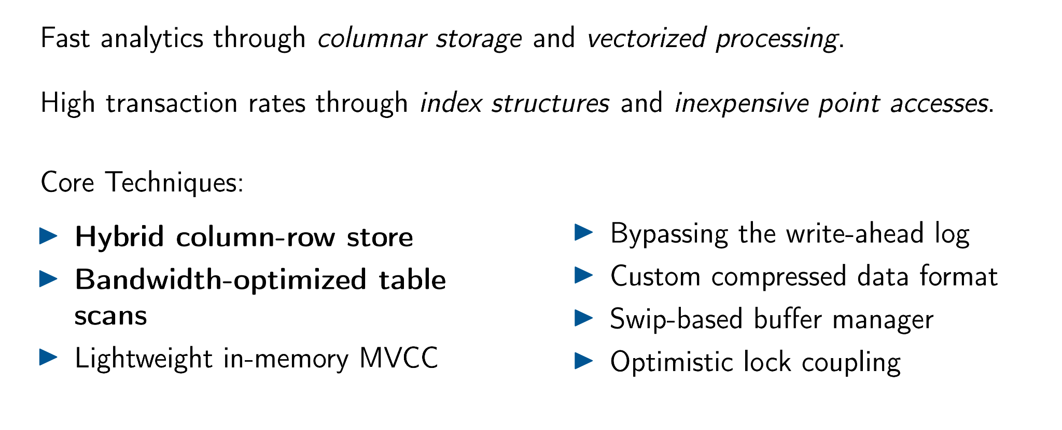
Colibri：Designing a Hybrid Cloud Storage Engine for HTAP

Slide 12
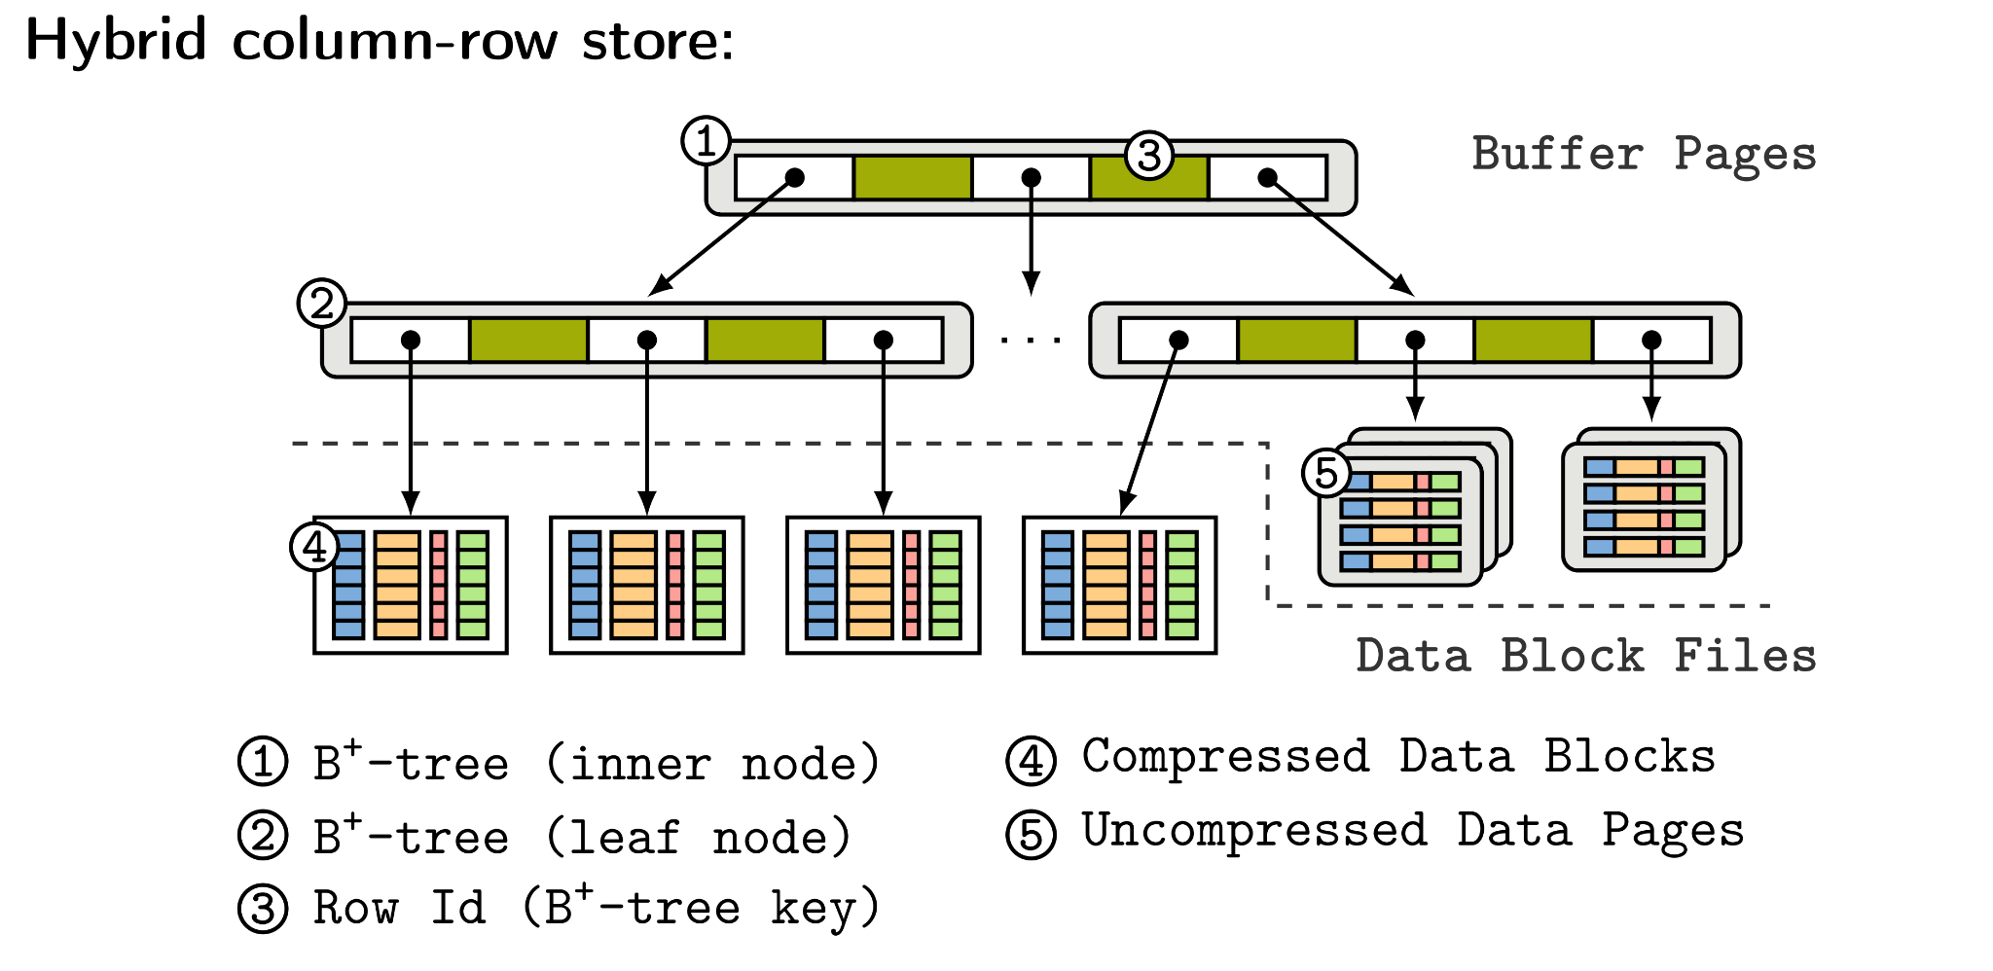
Colibri：Designing a Hybrid Cloud Storage Engine for HTAP

Slide 13
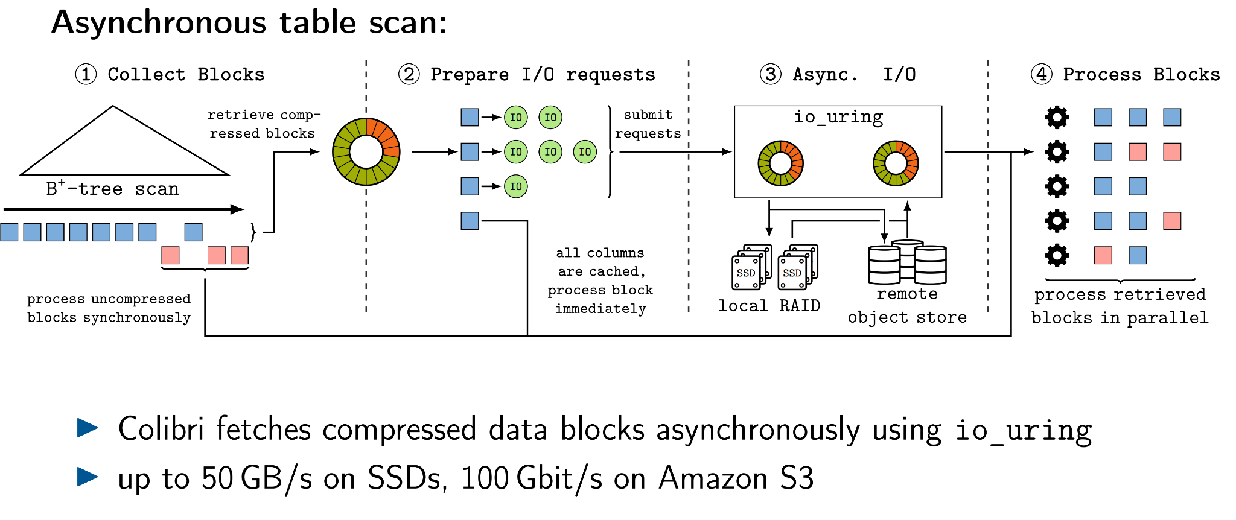
Colibri：Designing a Hybrid Cloud Storage Engine for HTAP

Slide 14
Colibri：Designing a Hybrid Cloud Storage Engine for HTAP
一些启发：
系统性研究更侧重于完整性与实用性，创新点会弱化一些
把一个简单的想法应用于系统中并不是一个easy过程
-> 想的太多，不如“折腾”做出来
一个“好”的系统研究需要长期的积累，Colibri-> Hyper+Umbra+LeanStore+vmcache+cost-efficient CloudDB

Slide 15
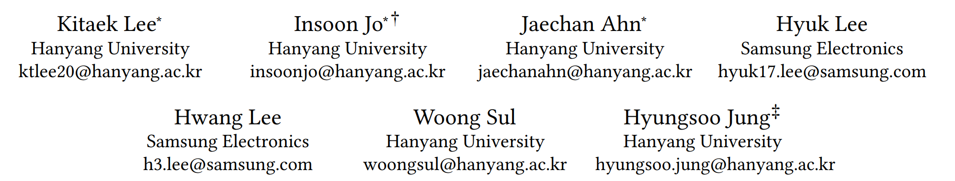
Deploying Computational Storage for HTAP DBMSs Takes More Than Just Computation Offloading
Weaver: Rethink the scan in mvcc databases. SIGMOD 2021
Diva: Making mvcc systems htap-friendly. SIGMOD 2022

Slide 16
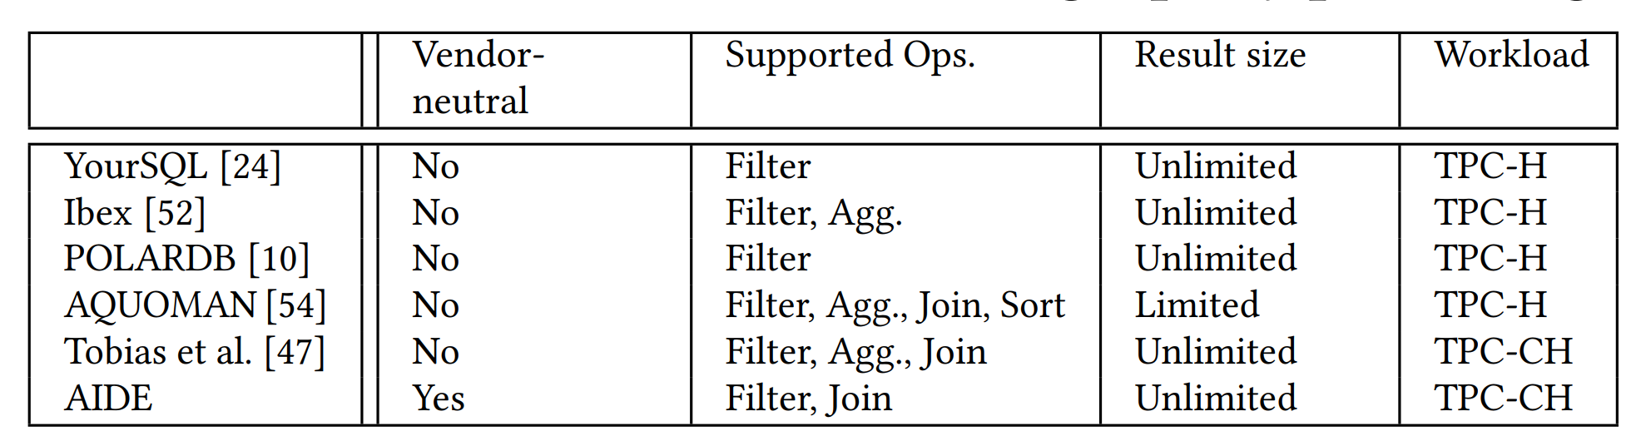
Deploying Computational Storage for HTAP DBMSs Takes More Than Just Computation Offloading
Motivation 1: Recent research pursues the potential of in-storage processing (ISP) using commodity computational storage devices (CSDs).
Motivation 2: Data items keep changing, hindering the active deployment of CSDs.
Motivation 3: Finding visible data versions incurs excessive data access in CSDs.

Slide 17
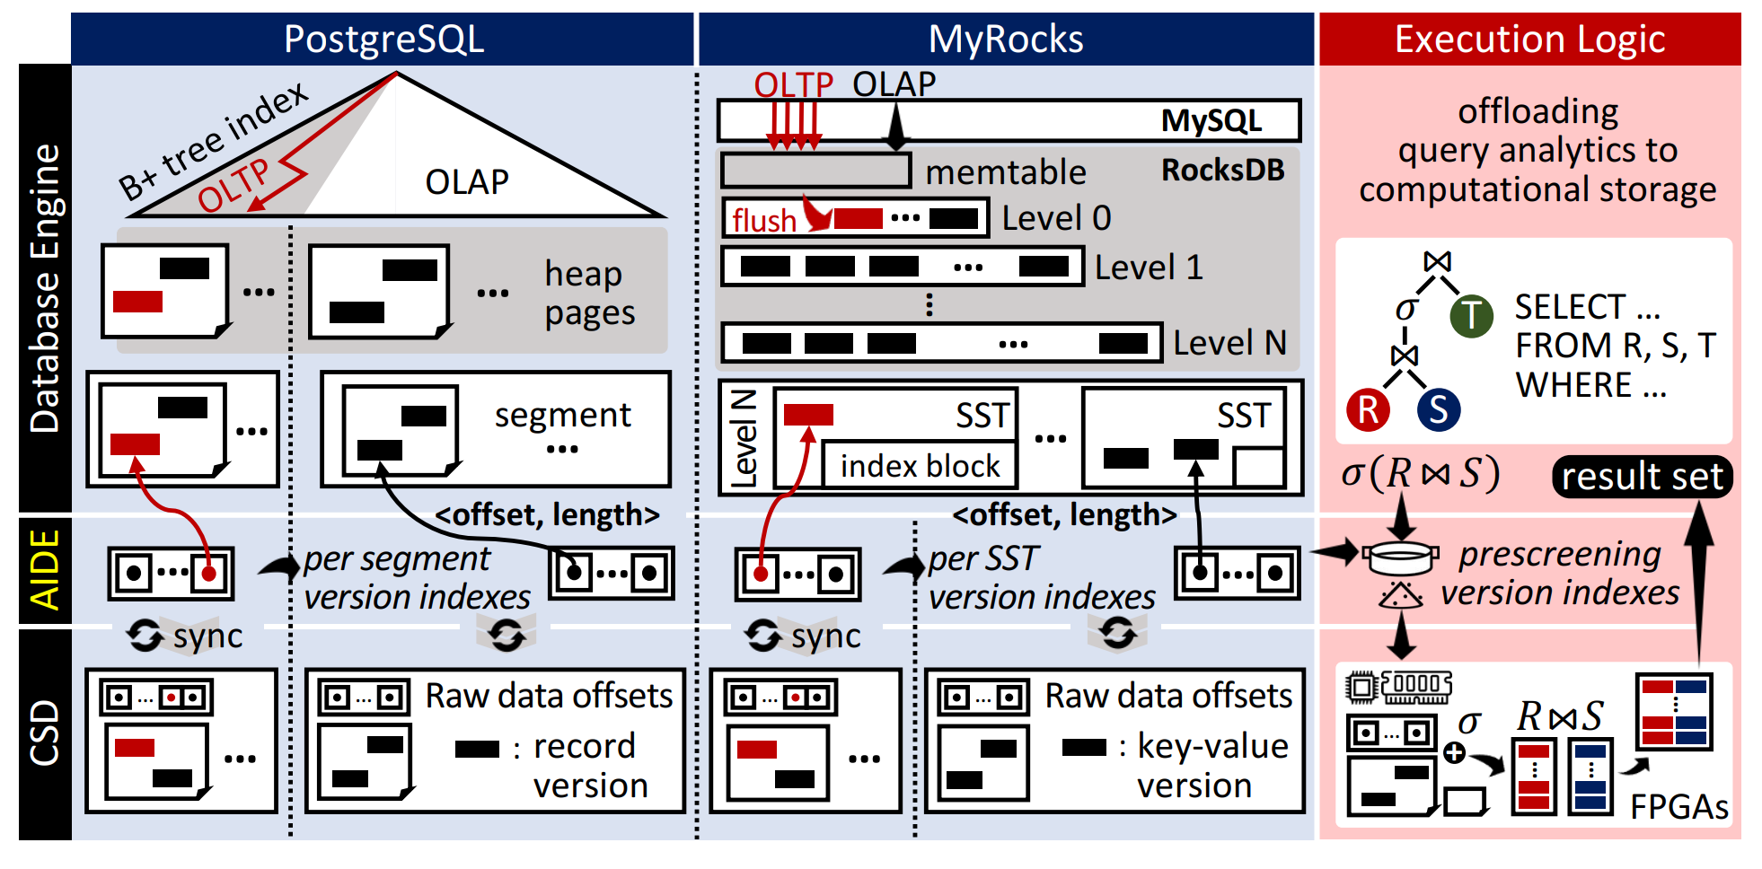
Deploying Computational Storage for HTAP DBMSs Takes More Than Just Computation Offloading
Contribution 1: Vendor-neutral computation with version indexes.
Contribution 2: Prescreening of version indexes.
Contribution 3: A prototype for PostgreSQL and MyRocks, demonstrating that AIDE supports efficient ISP for two databases using the same FPGA logic.

Slide 18
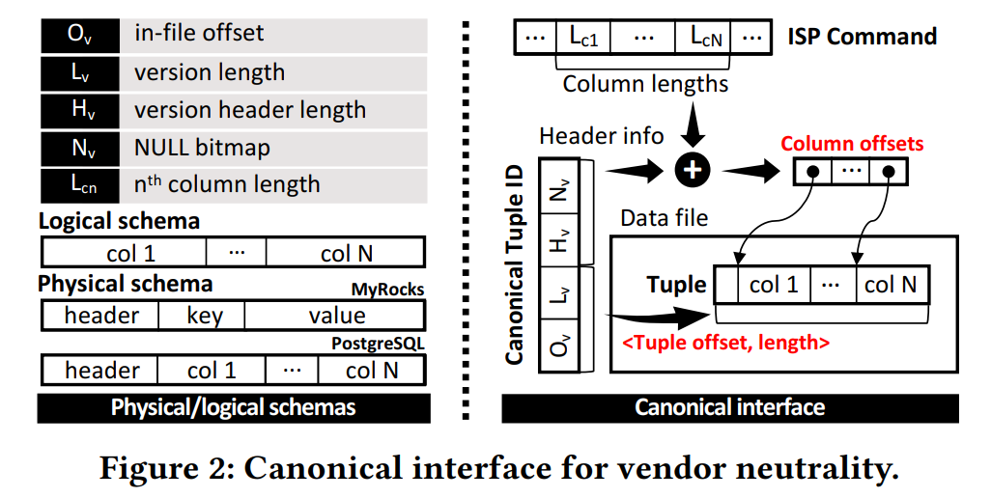
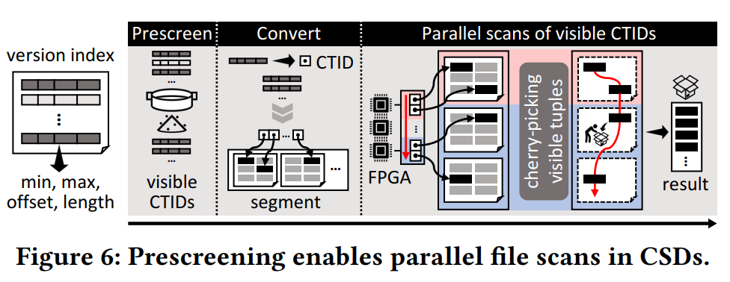
Deploying Computational Storage for HTAP DBMSs Takes More Than Just Computation Offloading
技术点一：Canonical Interface
技术点二：Prescreening CTIDs

Slide 19
Deploying Computational Storage for HTAP DBMSs Takes More Than Just Computation Offloading
一些启发：
在新硬件领域与厂商直接合作研究会“事半功倍”
系统研究重点可以从“First” 到 “Best”
技术点不用太多，需要做“深”做“实”

Slide 20
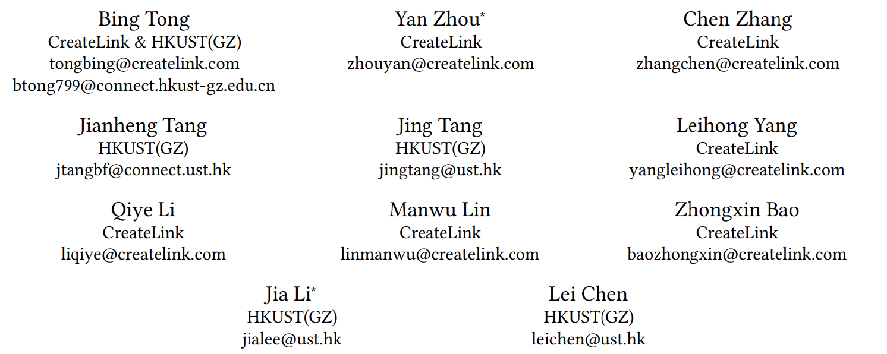
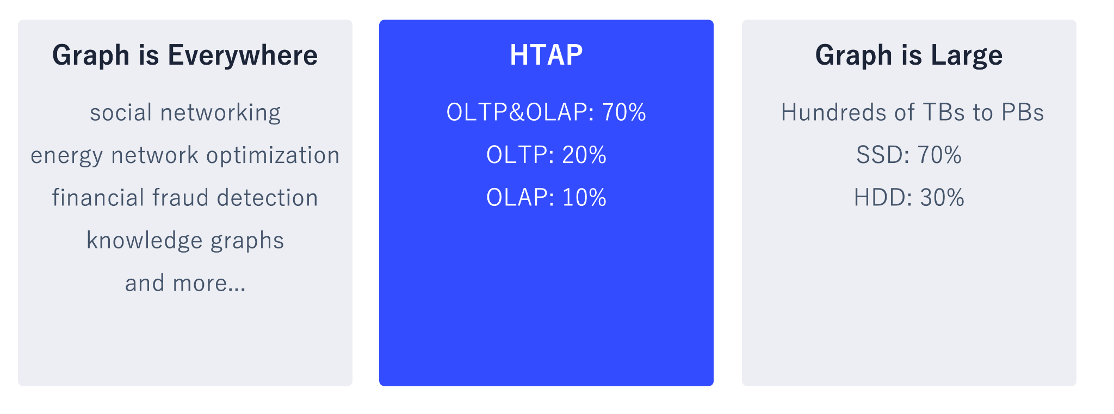
Galaxybase: A High Performance Native Distributed Graph Database for HTAP

Slide 21
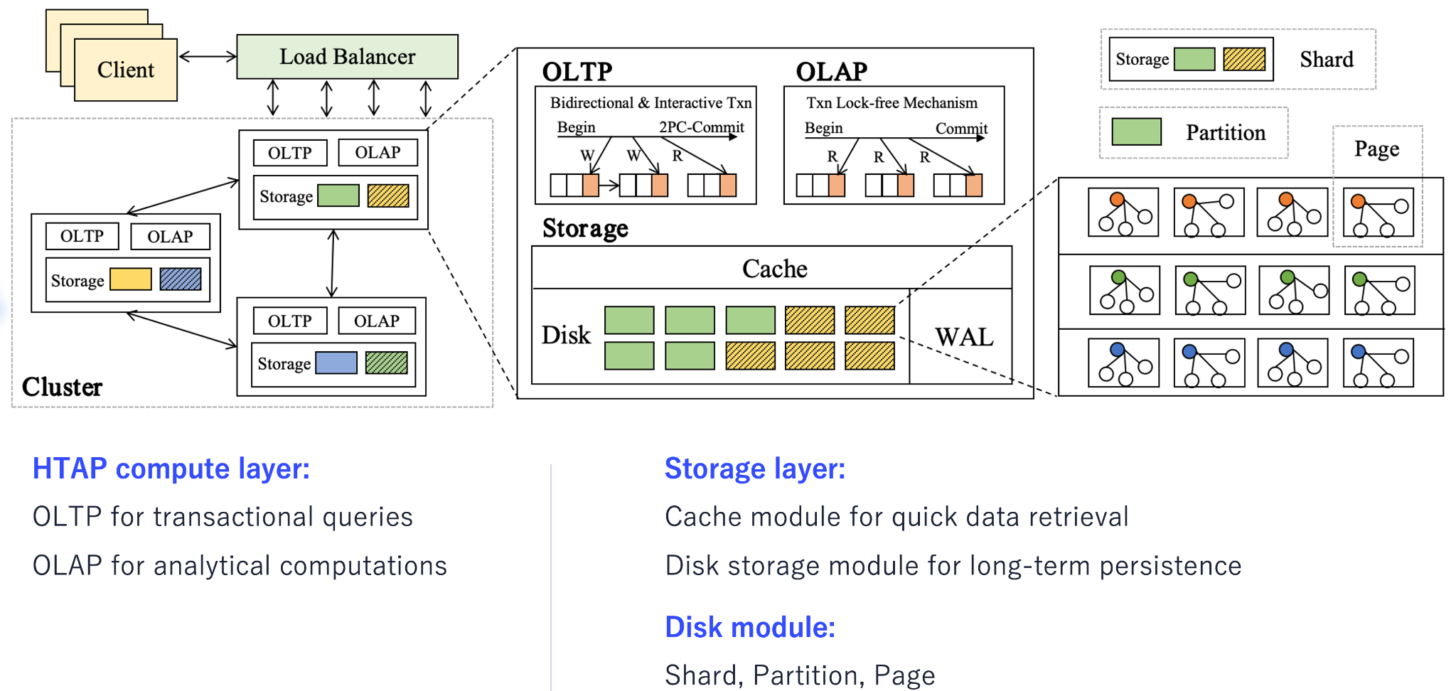
Galaxybase: A High Performance Native Distributed Graph Database for HTAP

Slide 22
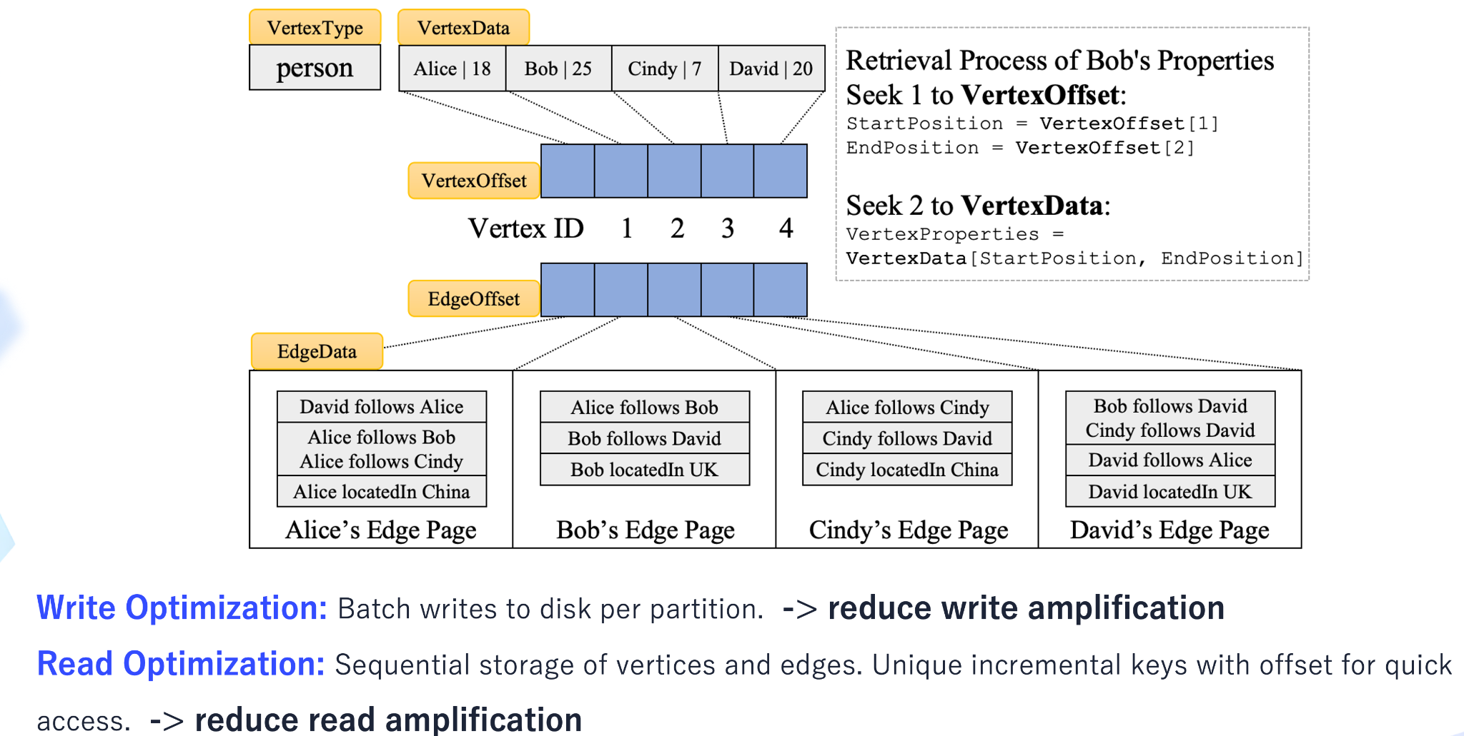
Galaxybase: A High Performance Native Distributed Graph Database for HTAP

Slide 23
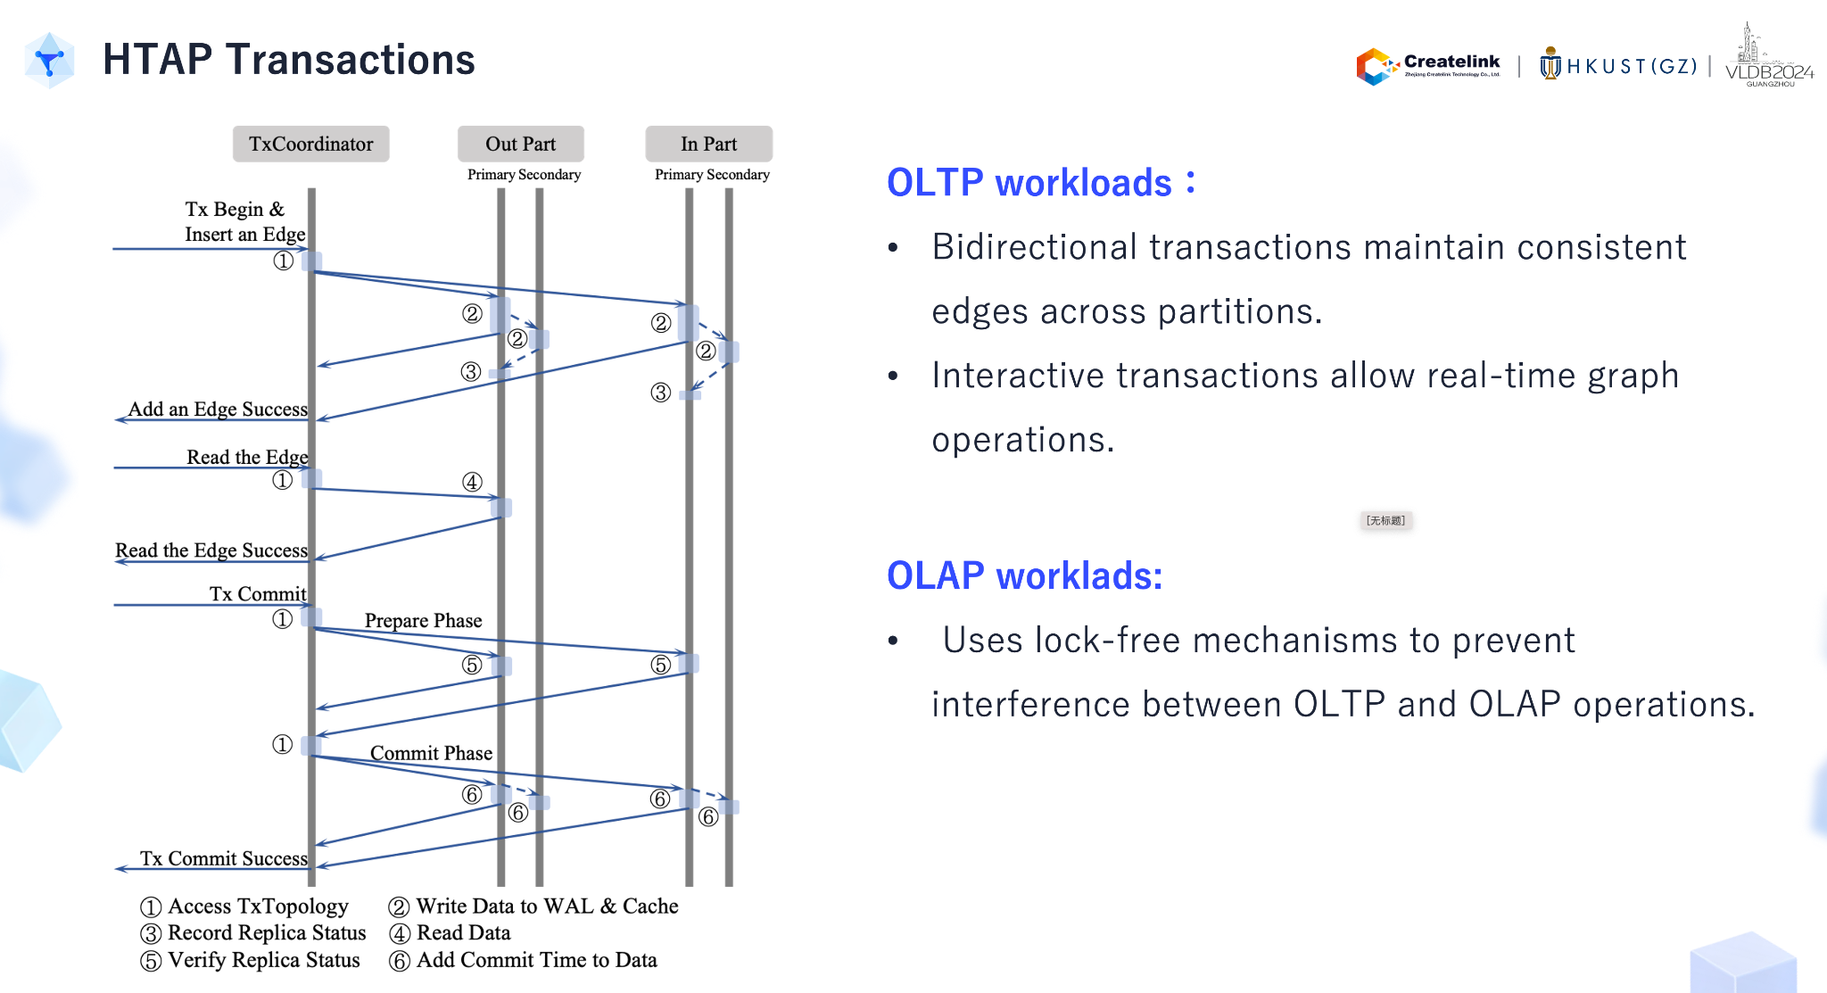
Galaxybase: A High Performance Native Distributed Graph Database for HTAP

Slide 24
Galaxybase: A High Performance Native Distributed Graph Database for HTAP
一些启发：
HTAP应用在分布式图数据库上的可行性
Graph-based HTAP当前缺乏新鲜度保证以及验证机制

Slide 25
论文列表(云数据库+HTAP)
HTAP趋势：HTAP与云数据库、新硬件、多模不断融合, 技术重心从“计算”逐渐转到“存储”
HyBench: A New Benchmark for HTAP Databases. PVLDB, 2024.
Two Birds With One Stone: Designing a Hybrid Cloud Storage Engine for HTAP. PVLDB, 2024.
Cloud-native transactions and analytics in singlestore." Proceedings of the 2022 International Conference on Management of Data. 2022.
Deploying Computational Storage for HTAP DBMSs Takes More Than Just Computation Offloading. PVLDB, 2023.
Galaxybase: A High Performance Native Distributed Graph Database for HTAP. PVLDB, 2024.
===============================================================================================================
云数据库趋势：多写技术、Cost-Efficiency、持续发展
GaussDB: A Cloud-Native Multi-Primary Database with Compute-Memory-Storage Disaggregation. PVLDB, 2024.
Resource Management in Aurora Serverless. PVLDB, 2024.
Srivastava, Tapan, and Raul Castro Fernandez. "Saving Money for Analytical Workloads in the Cloud." PVLDB, 2024..

Slide 26
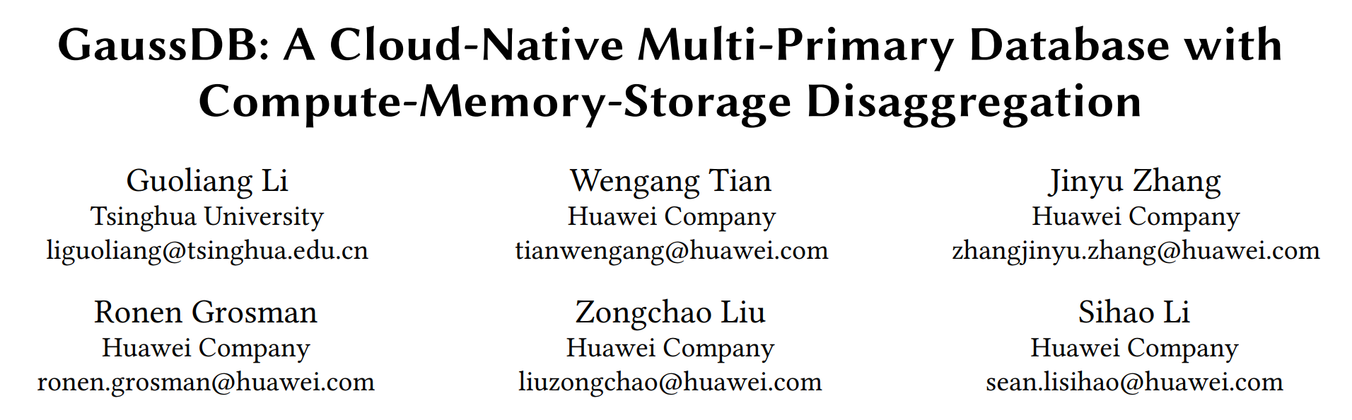

Slide 27
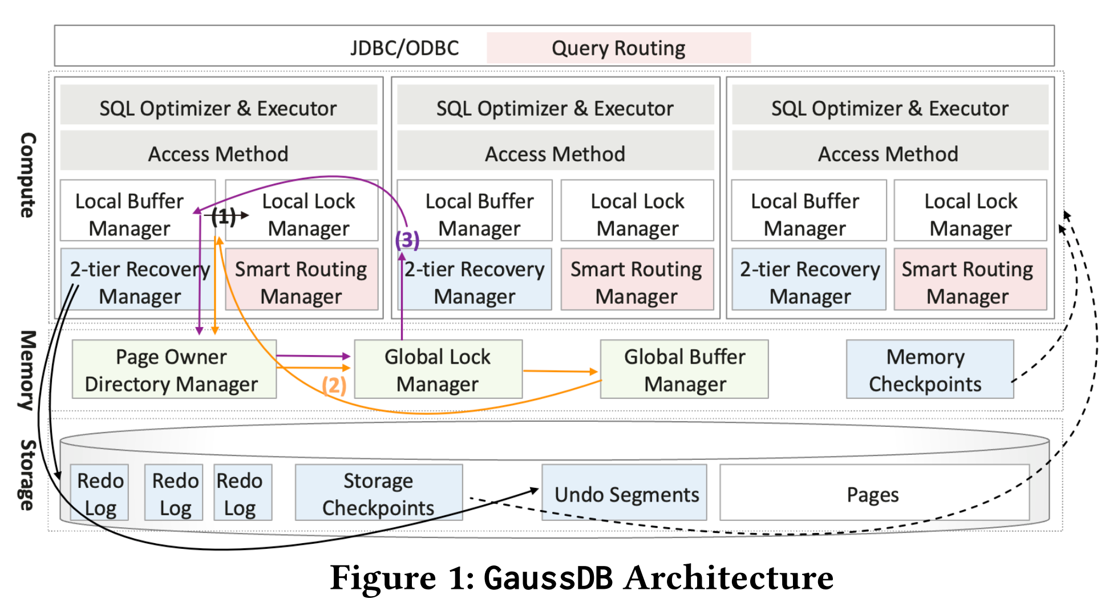
GaussDB: A Cloud-Native Multi-Primary Database with Compute-Memory-Storage Disaggregation

Slide 28
GaussDB: A Cloud-Native Multi-Primary Database with Compute-Memory-Storage Disaggregation
一些启发：
三层架构引领多写技术持续发展
分布式事务转单机事务，结合Smart Routing是亮点！
未来CXL技术大有可为！

Slide 29
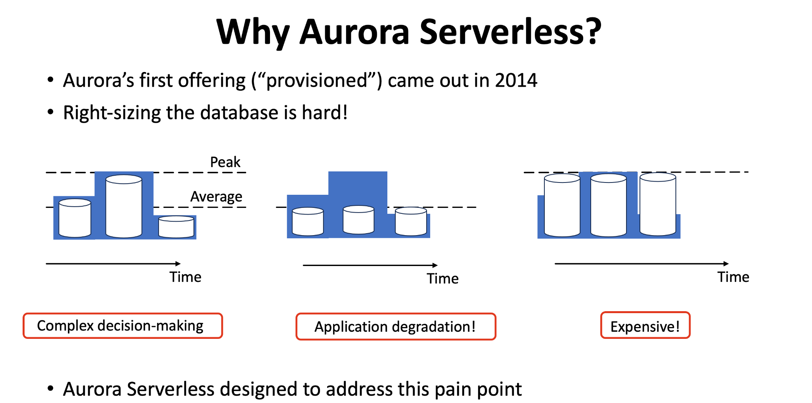
Resource Management in Aurora Serverless

Slide 30
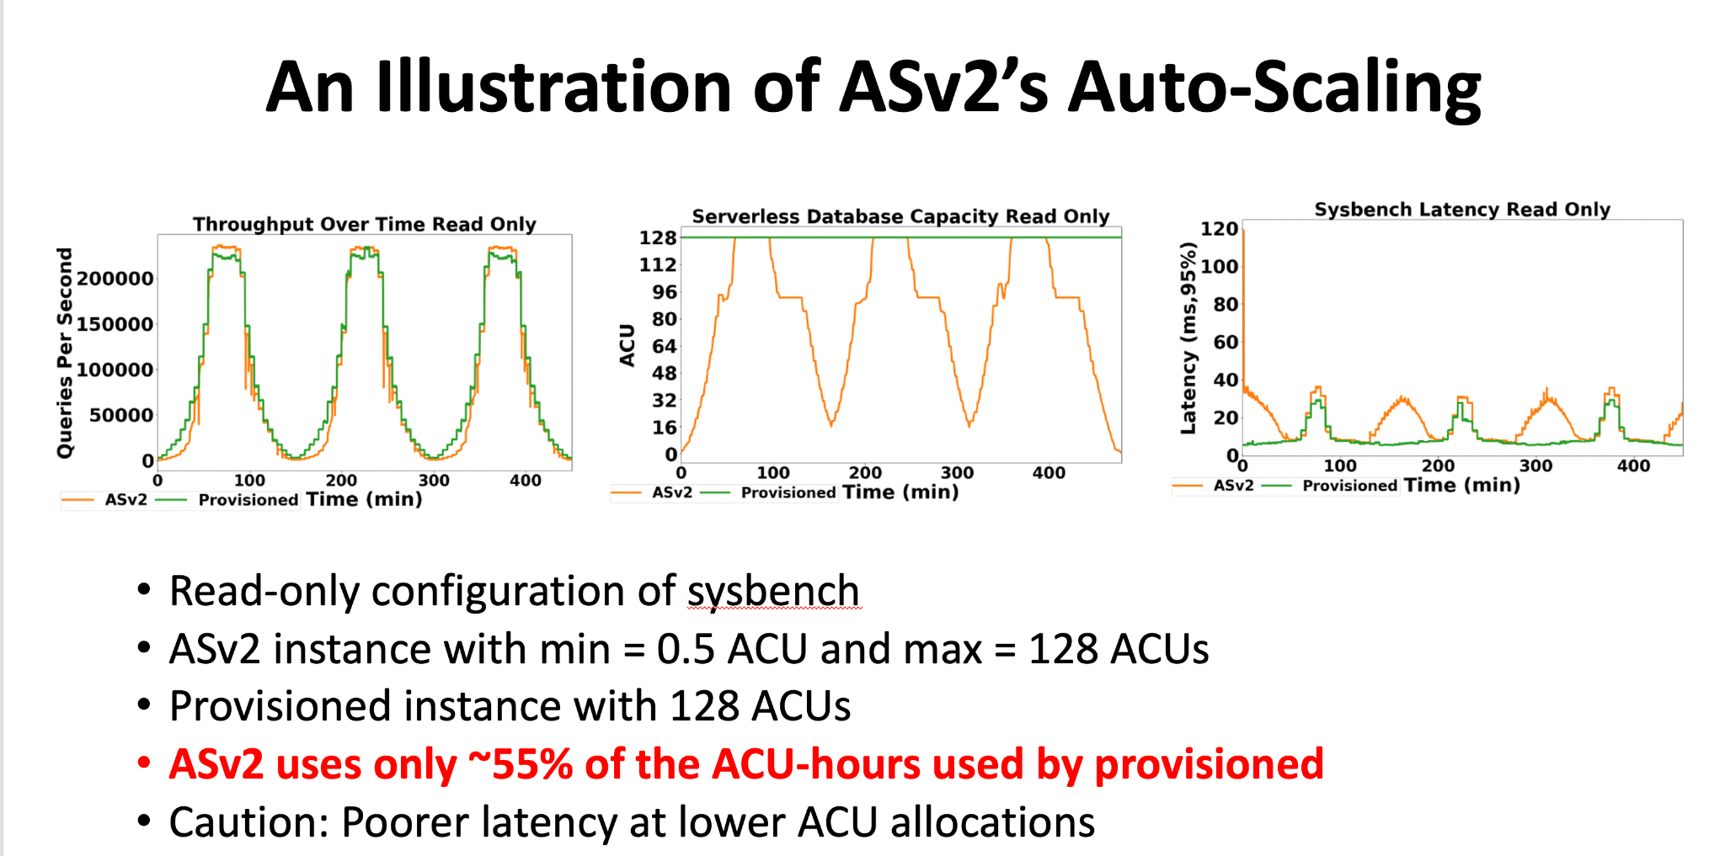
Resource Management in Aurora Serverless

Slide 31
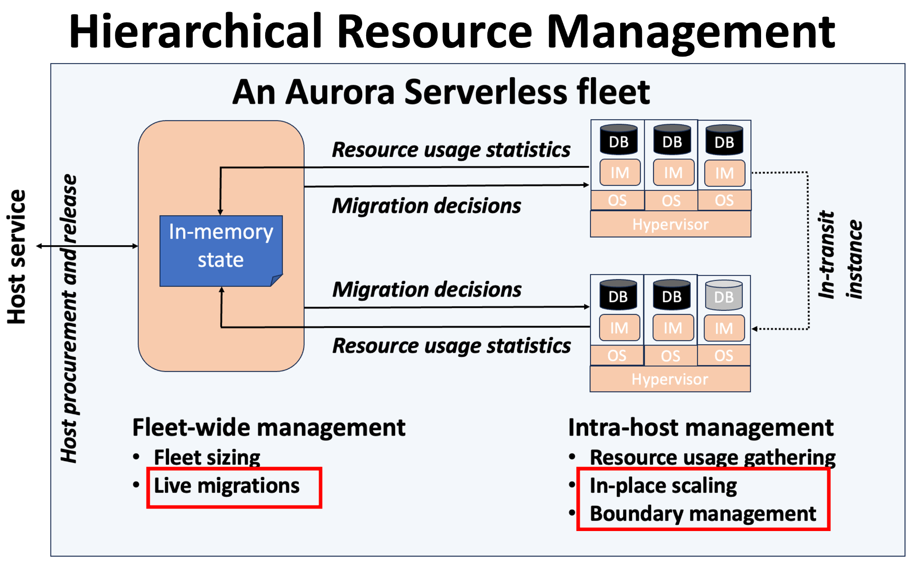
Resource Management in Aurora Serverless

Slide 32
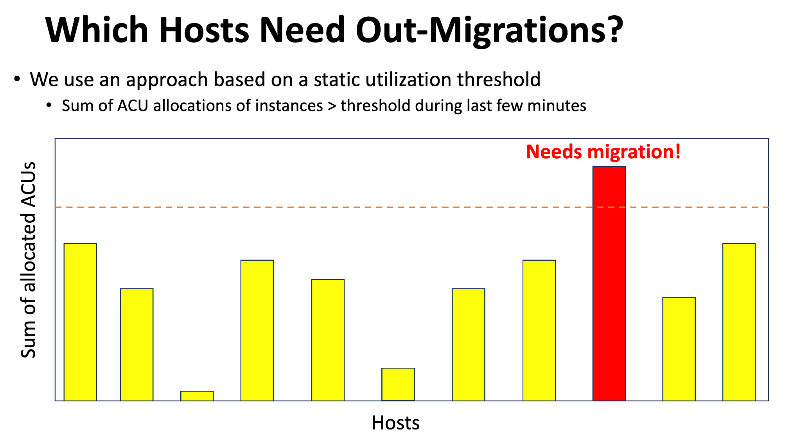
Resource Management in Aurora Serverless

Slide 33
Resource Management in Aurora Serverless
一些启发：
云上动态资源调度很重要，但需要考虑Cost-Efficiency!!
保持批判性思维，不要迷信“最佳论文”或者“国外先进技术”!!

Slide 34
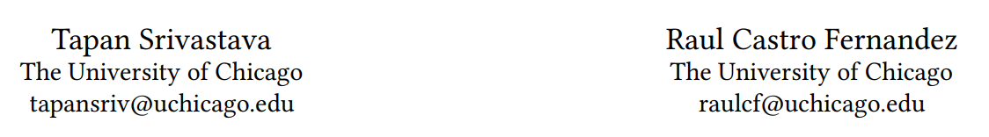
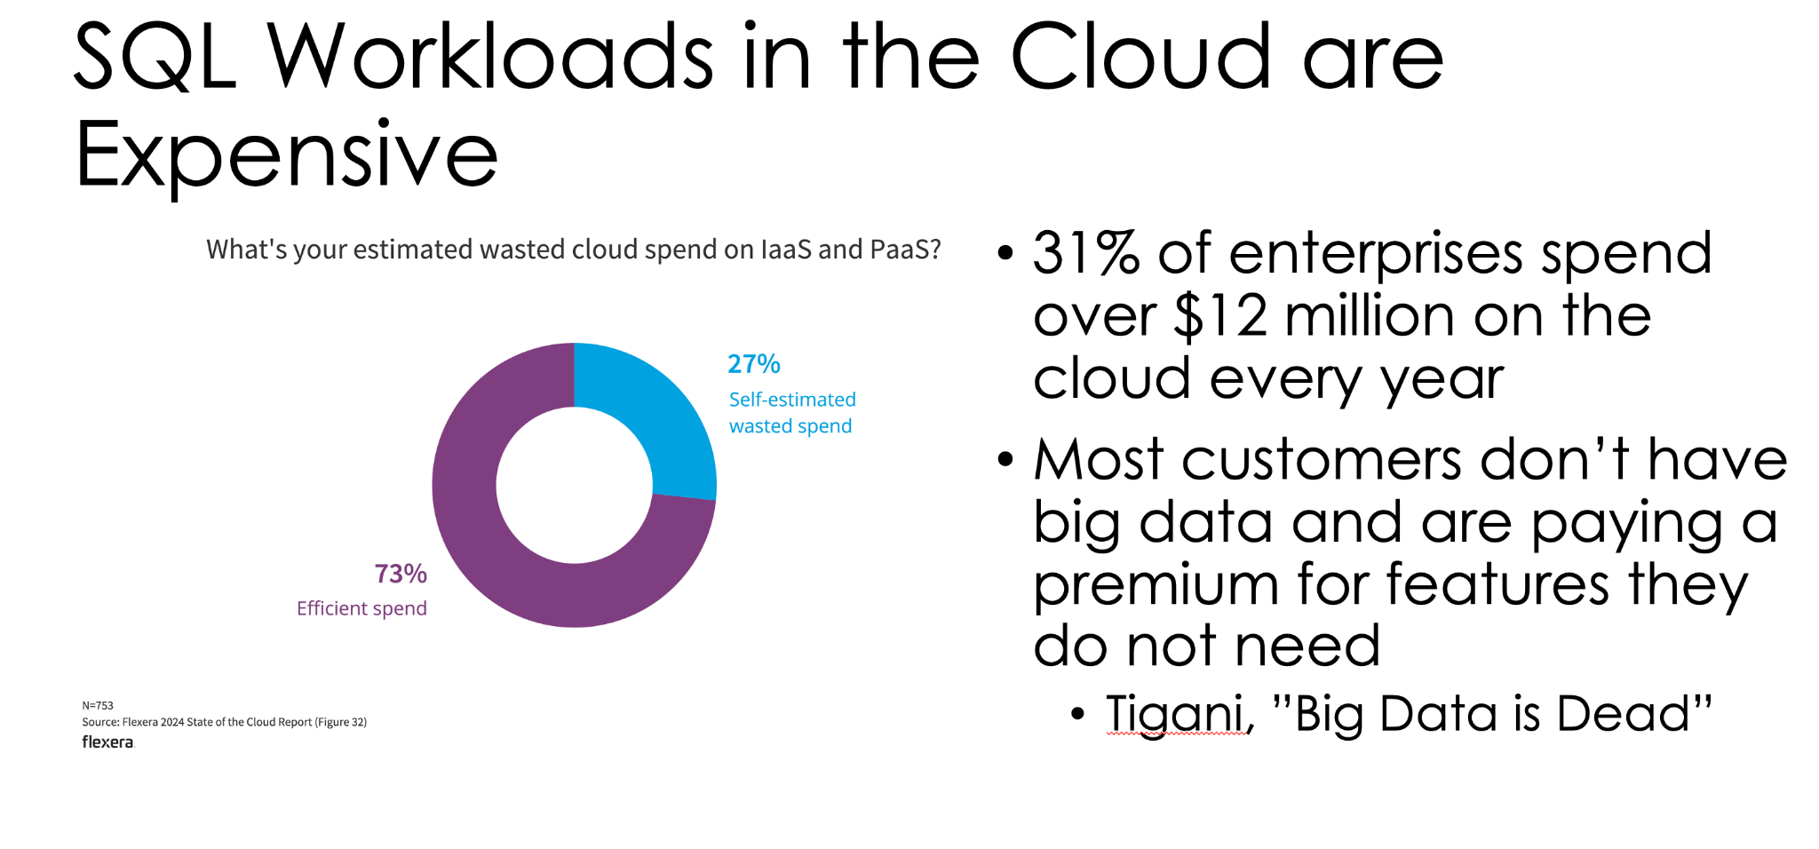
Saving Money for Analytical Workloads in the Cloud

Slide 35
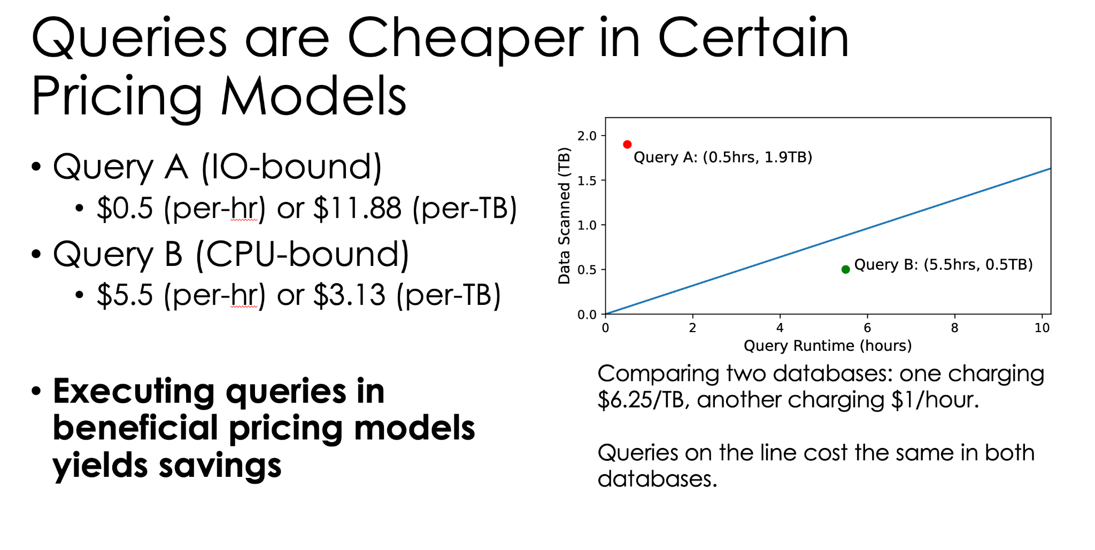

Slide 36
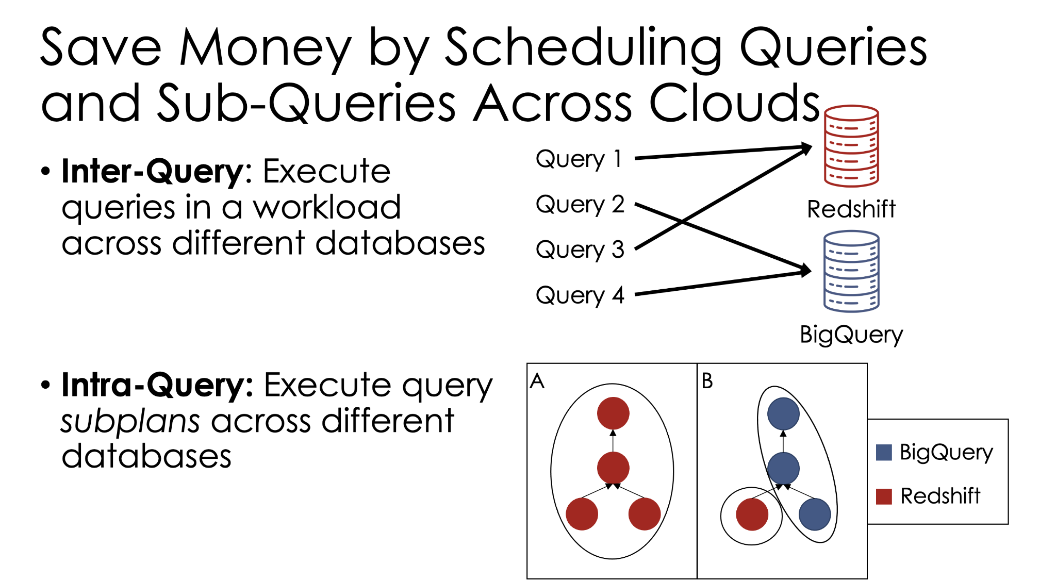

Slide 37
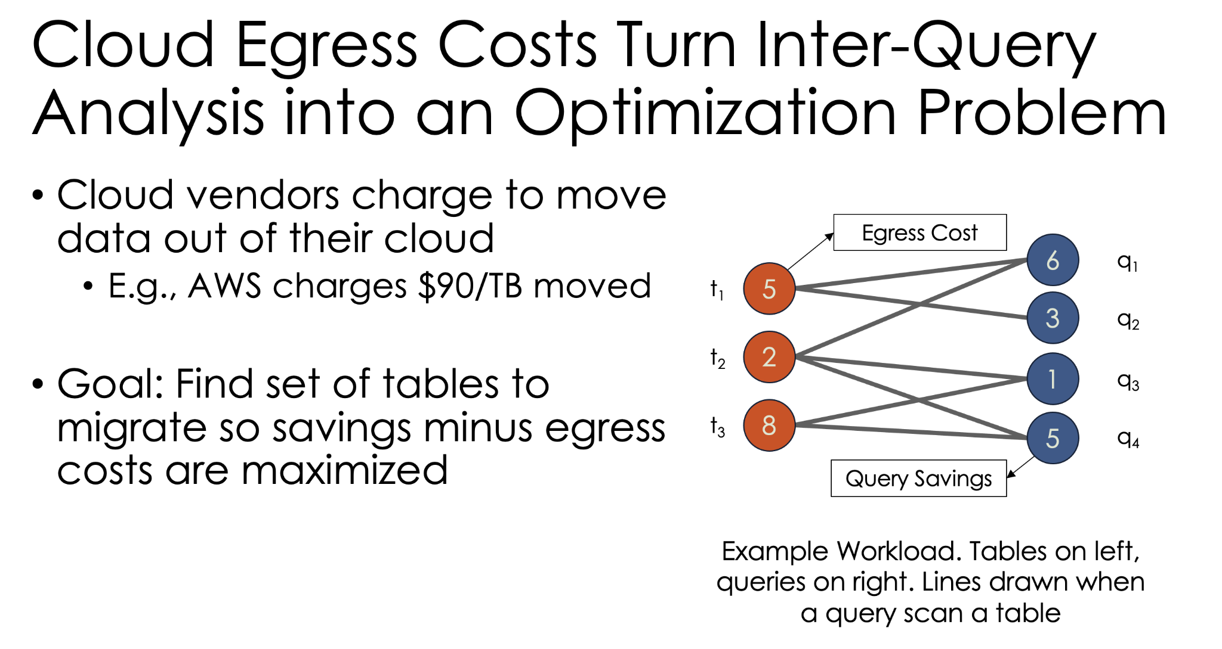

Slide 38
Saving Money for Analytical Workloads in the Cloud
一些启发：
云上cost-efficiency是否一定要考虑多数据库场景？
Saving Money是否需要考虑run time？

Slide 39
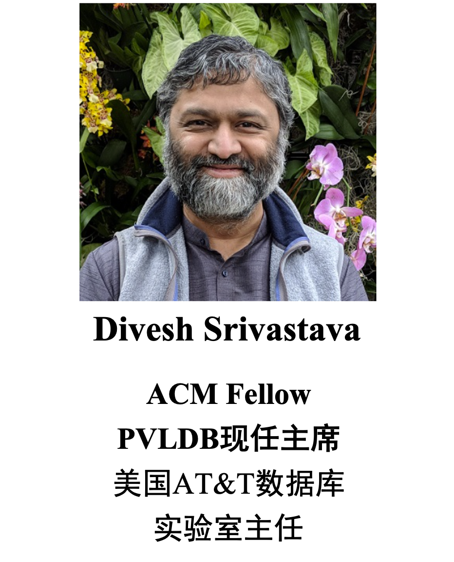
To be honest
To be helpful
谢谢！Q&A

